Slide 1
Aws Deployment

Slide 2
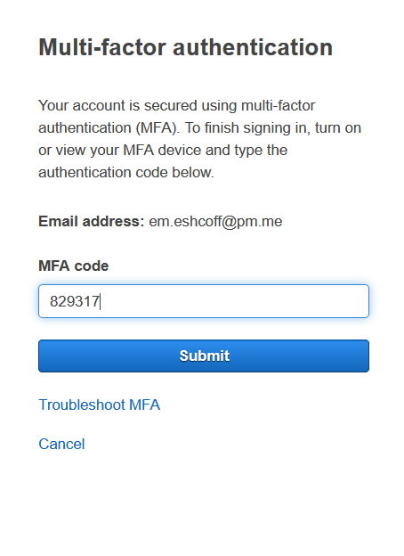
Multi Factor Authentication
This is a vital step for ensuring the security of the resources being used in this deployment. As a root user in a free tier system, lack of security here prevents the destruction of needed resources or the creation of resources that might incur costs

Slide 3
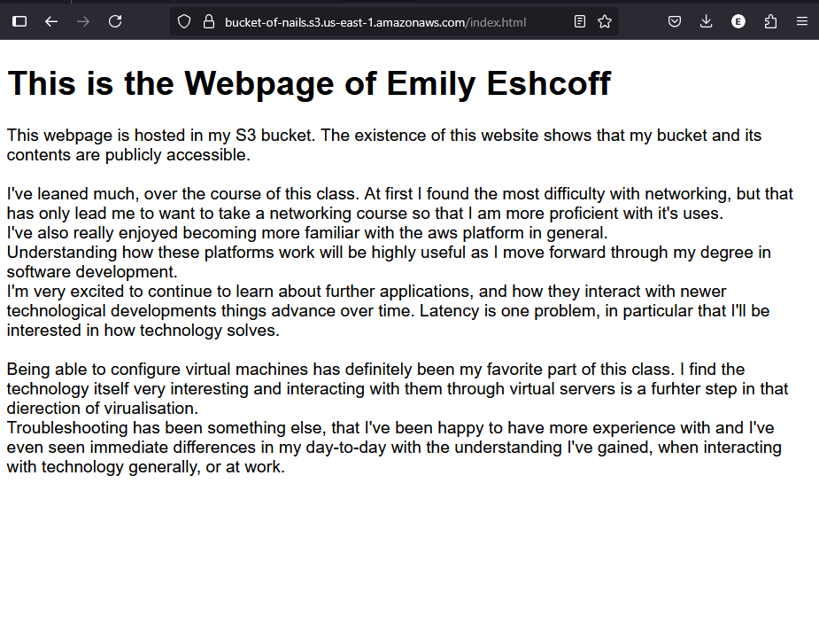
S3 storage
S3 storage, called buckets, are a fantastic solution for cloud storage, they’re scalable and easy to make publicly accessible, especially for use cases with static websites

Slide 4
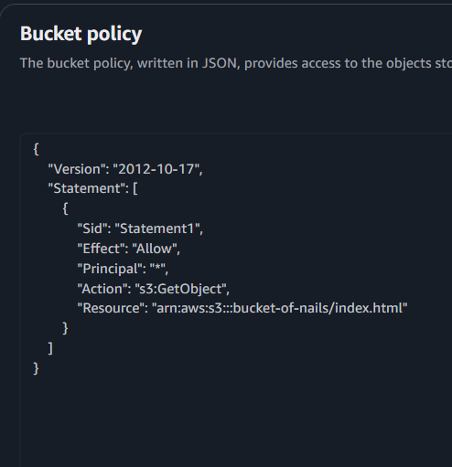
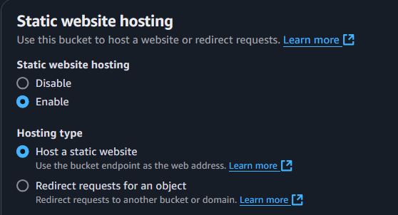
The bucket policy, and public access

Slide 5
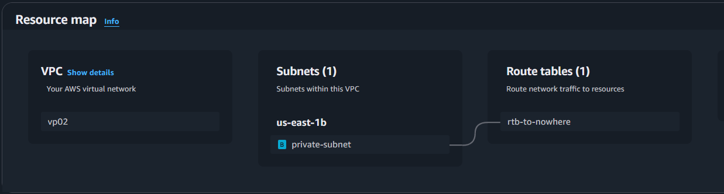
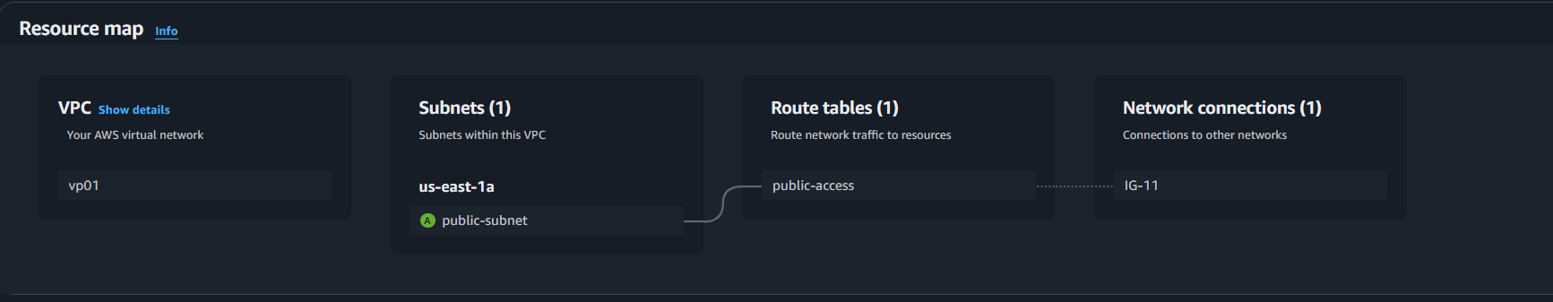
Configuration of the VPC, rtb, and IGW

Slide 6
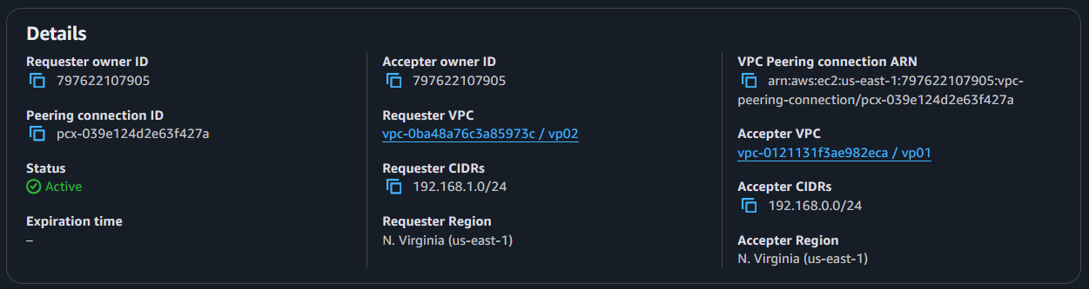
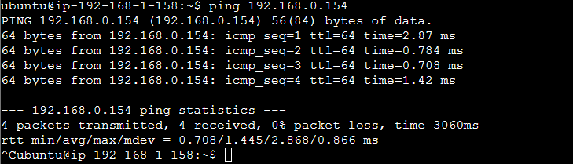
Peering the connection
These images show the active connection, and proof that the internet connected vm which is being remoted into from my home pc is able to find the private vm on the network.

Slide 7
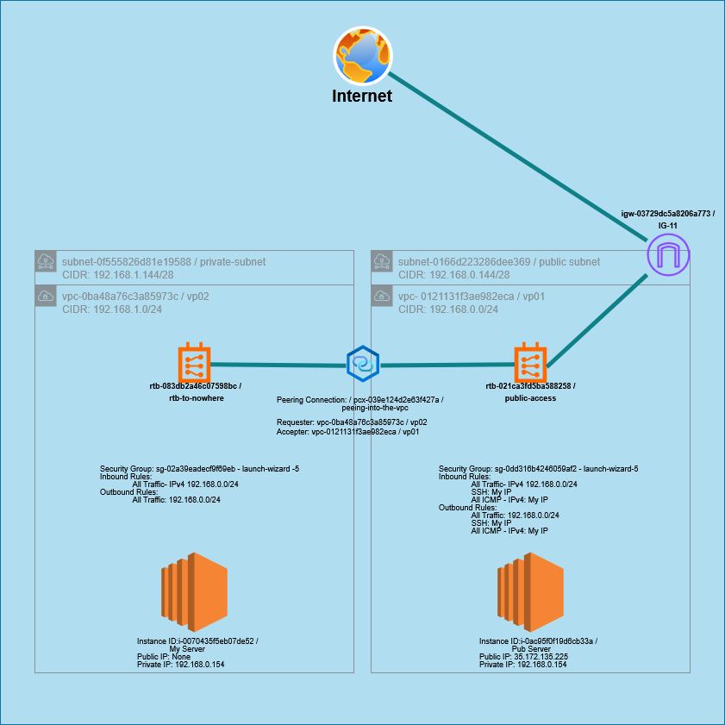
The full deployment
My full deployment of the environment is shown with the given diagram
Associated CIDR blocks, layout and relationship of VPCs to their respective subnets, vm instances, and connections to routing tables, and the singular peering connection, and internet gateway. The central text in each VPC represents the security group IDs and the settings that are configured to permit the required communications.

Slide 8
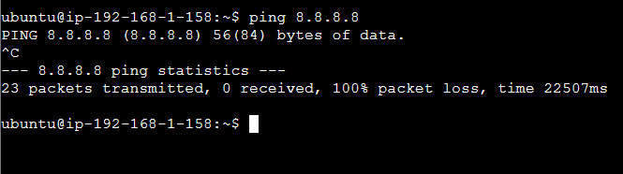
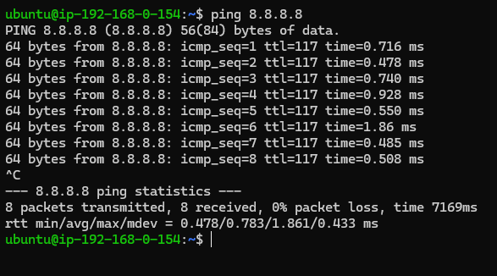
Proof of network communication and security group permissions
The pings here display the respective VM sessions attempts to make connection with the internet at 8.8.8.8
Packet loss shows a lack of connection while repeated pings show sent and received ICMP IPv4 communication over the internet as permitted by security settings and the connection through the IGW

Slide 9
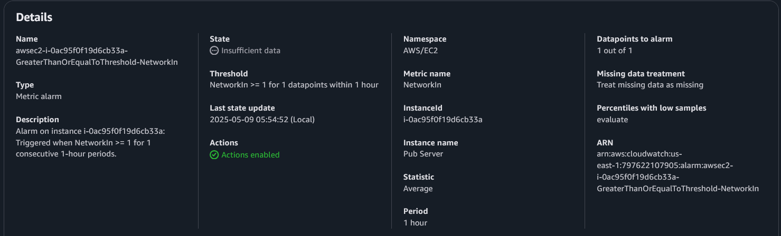
System Monitoring
Now that the system is active, and working properly, we need to be able to keep track of what’s happening. Alarms are one way to have immediate access to knowing when a connection is made, or changes along other metrics. This alarm is configured to send emails any time that a network connection is sent into the public VM.

Slide 10
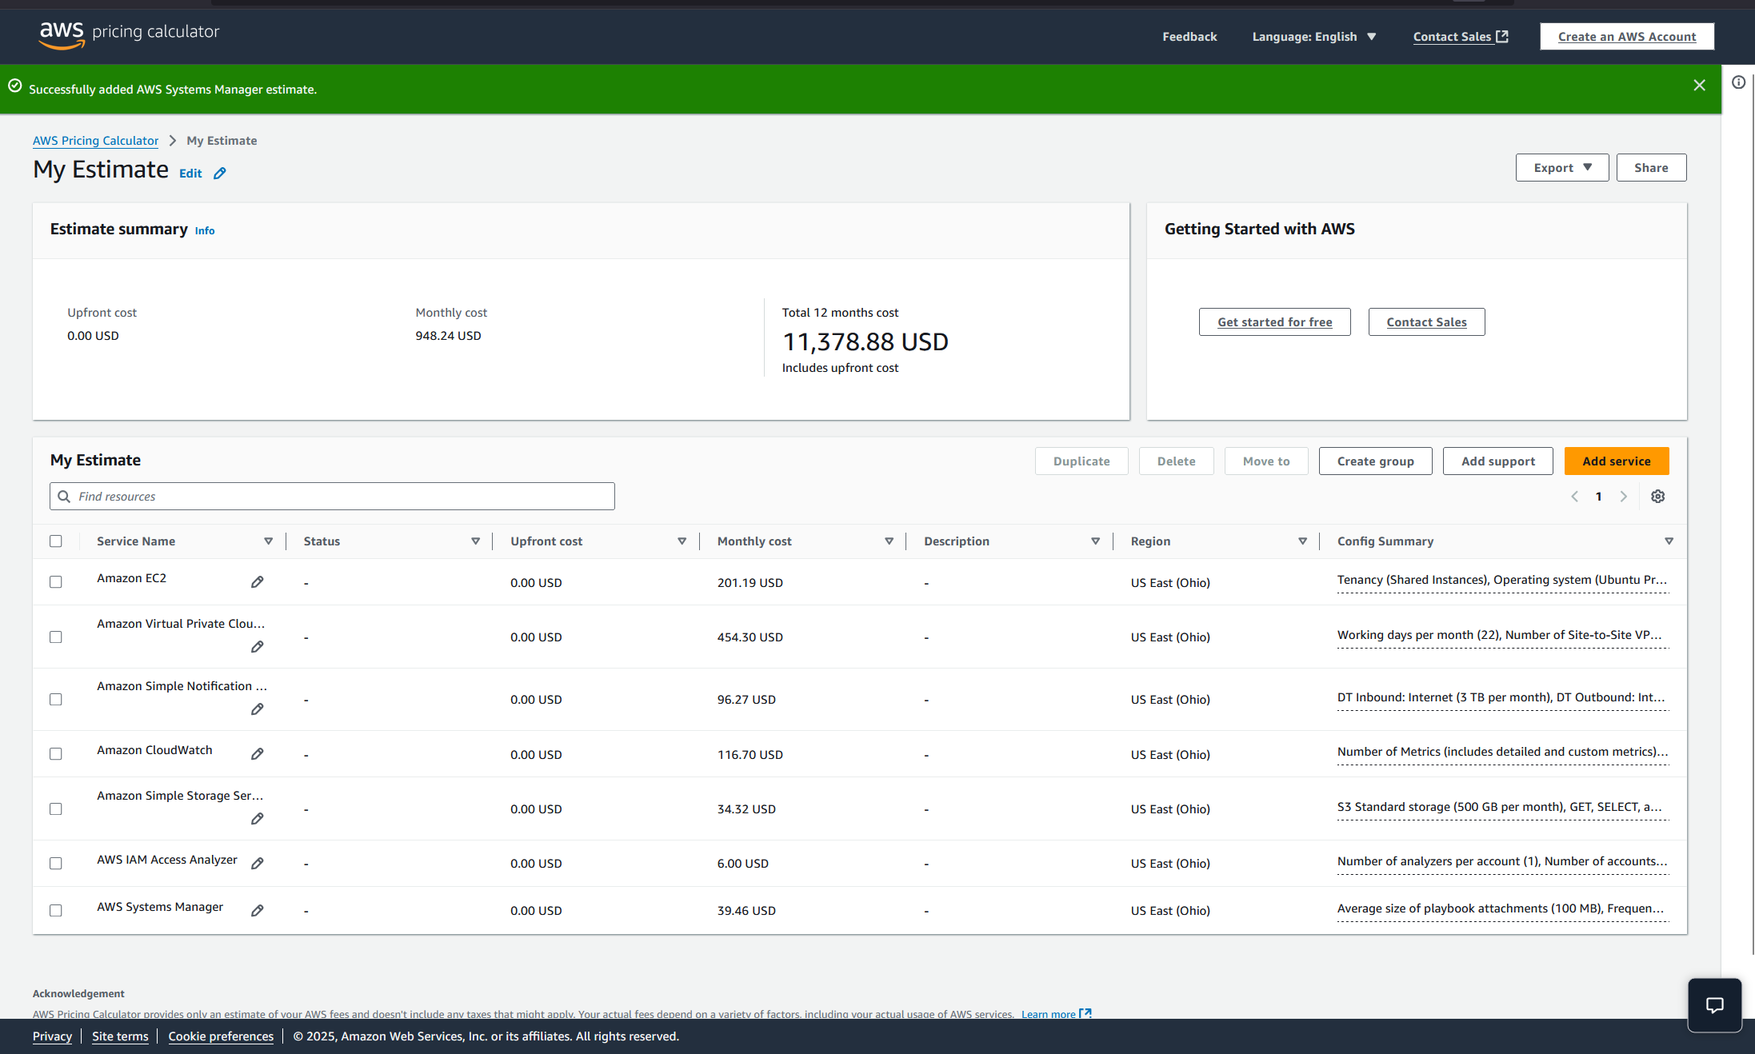
Long Term Maintenance
Using the AWS Pricing Calculator, We’re able to get an estimate of what it could cost to maintain this network environment over the course of 12 months, broken down by resource category.

